Slide 1
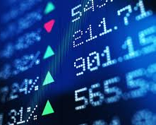
How has the automotive industry stock prices performed in 2020?
Contributors:
Melissa Smashey Mark Munanura
Tiffany McGowan Matt Egan
Notes:
Auto Companies Will Outlast COVID-19 and Come Out Stronger

Slide 2
With the covid pandemic, we wanted to analyze the performance of automotive industries stock performance.
Given the stay-at-home order mandated by most if not all states, we wanted to look at which manufacturers preformed best given these unusual circumstances.
Motivation

Slide 3
What type of questions did we want to answer?
Which stock in the industry was the best investment?
Was that stock highly risk dependent?
Is there a strong correlation between manufacturer region and their adjusted close price?
Was manufacturer region or market segment more important to manufacturer performance?

Slide 4
Take ford moving avg chart and place here
Notes:
We started of by listing the largest car munufacturers in each region (Asia, Europe, U.S.)
We imported their historical trading data using the Yahoo Finance python module (yfinance).
Used describe function to ensure that all dataframes had 253 records and that there were no NA/NAN records.
2. To get a better understanding of how the stocks were performing we created graphs that evaluated adj. close and volume over the past year. We also used(averages)….

Slide 5
Look at distributions of returns
Get picture of a single bar graph (has bins) and box and whisker plot of daily returns for Europe.
Notes:
This can give us insight to how risky that stock is. Higher variance in returns signifies a higher risk investment.

Slide 6
Problems
American car companies have subsidiaries in the tickers.
Displaying the data concisely.
Amount of data. Had difficulties figuring out what was important to show.
What figures matter and how do they interact.
-adj close
-whats risk and how do determine

Slide 7
Interesting findings from exploration
During March covid basically havled all manuf. Stock price
Tesla recovery.

Slide 8
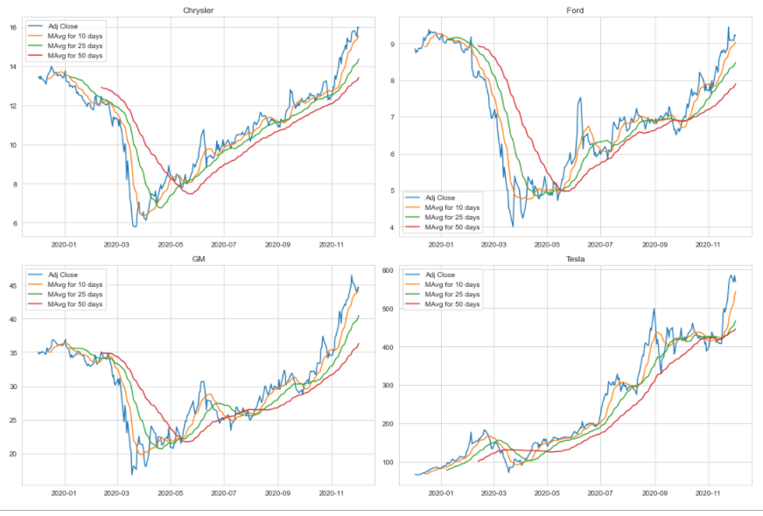
Interesting findings

Slide 9
Quick Financial Lesson
Adjusted Close
- What is it?
- Why is in necessary?
Risk:
- How can you tell if company is a riskier investment than another.
- Is higher risk worse?
Monte Carlo:
- What is it?
- why you use it?
Notes:
At a high level, economic shocks and corresponding rebounds typically take one of three shapes:
V Shape. A classic economic shock that leads to a pronounced downtown, followed by a rapid rebound to the original output path.
U Shape. A shock, such as a financial recession or major policy error, that breaks a growth trend and causes a pronounced downtown that is sustained for a time before recovery begins.
L Shape. A shock that causes irreparable damage and leads to a perpetually growing loss of present value and future output, resulting in a fundamentally changed growth trajectory.

Slide 10
Heatmap slide
Heat map
Notes:
Show heat

Slide 11
Manufacturer Correlation Region
U.S. Manufacturers
European Manufacturers

Slide 12
Manufacturer Correlation by Market Segment

Slide 13
Expected returns vs risk

Slide 14
Monte carlo
Monte Carlo:
- What is it?
- why you use it?

Slide 15
Monte carlo simulations
Images here:
Risky: tesla Hyundai
Normal: Toyota, Ford

Slide 16
Questions and further analysis
If we had more time, we would want to look at additional factors, how effect on supply chain on companies.
Varying lockdown measures in each region
Is there a way to predict stock price with social media presence/setiment

